Slide 1
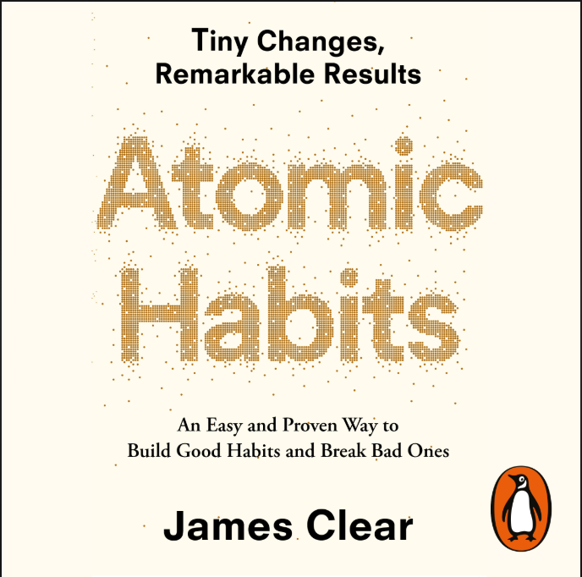
Atomic Habits
Tiny Changes , Remarkable Results

Slide 2
Just Improve By 1%
A one percent improvement per day becomes a 38-times improvement at the end of a year
A one percent reduction per day will result in a 0.03 times originally capacity by the end of the year.

Slide 3
A favourite quote of Jacob rills when I was depressed, I think of a stone cutter who repeatedly hammers on a stone. Even if he hits it a hundred times, the stone do not crack but when he hits it 101 times. The stone breaks into two pieces. Then I know that the stone broke not because of the last hit. But because of the 100th hits.
Another Example,
A piece of ice lying on the table. The room is very cold, it is also visible when we breathe. The temperature is -4degree. The piece of ice is the same. When the temperature drops to -3degree there is no change in the piece of ice. When the temperature drops to -1 degree there is no change but when the temperature drops to 0 degree the ice changes into water. A change of just one degree converted ice into water

Slide 4
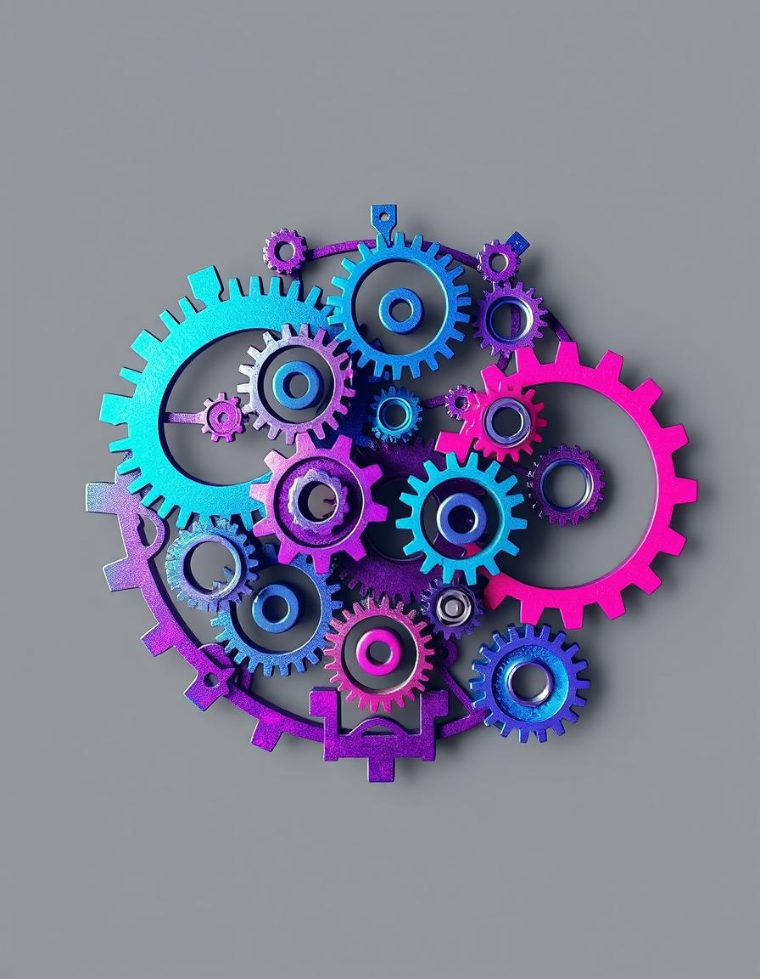
So we should focus on system and small habits not on Goal.
System over Goal
Concentrate on building effective systems.
2) Small Habits
Small habits are the foundation of an effective system.

Slide 5
Your environment is more powerful than motivation
Ex. doctor Annie conducted a study in her hospital. She wanted to change the environment without telling anyone and improve the eating habits of hospital staff members and visitors. For this, she made some changes in the hospital. There was bottles of coke and limca next to case counter. Now she filled it with water bottles in the next three months, the sales of coke and limca decreased by 11.4% while the sales of water increased by 25.8%.

Slide 6
Any Habit can be divided into four parts.
Cue
Craving
Response
Reward

Slide 7
Ex. A notification comes up on facebook that your friend has mentioned you in a comment. This notification is a cue to our brain. This cue is create craving in our mind. what would my friend have written about me and we should respond to it and see what my friend has written about me and if it says that you are looking like an actor. Then it becomes a reward for us and this loop always continues for reward.
Now if we want to use this concept to create a new Habit then
1)Cue has to be made obvious , Attractive to craving , Make response Easy and Reward has to be made satisfied.

Slide 8
Now if we want to break a bad habit like this.
To break bad habits, reverse the rules. Make the cue invisible, craving unattractive, response difficult, and reward unsatisfying.
For example we want to break the habit of opening social media app repeatedly.
Step1: we want to remove the cue, meaning we can turn off notification or silence the mobile.
Step 2 : Craving make it Unattractive , meaning make a disadvantage story
Step 3: response make it difficult that means we can keep the long password or phone away.

Slide 9
Thank you

